Slide 1




WFER Session 5d
Next generation of
consumer growth
Luca Lo Schiavo
ERRA Research Unit
Tbilisi, session 5d 24 Sept.2026

Slide 2
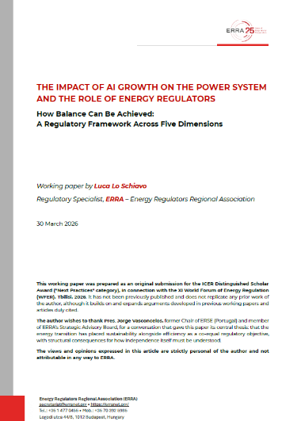
ERRA Research Paper: The Impact of AI Growth on the Power System
Four substantive dimensions
long-term predictability
operational reliability
economic affordability
and environmental sustainability
regulatory independence, that cuts across all four: the institutional condition that determines whether (and which) governance of the other four is possible at all
A fifth dimension
ICER Distinguished Scholar Award Winner
in the Next Practices Category (WFER 2026)
https://erranet.org/research-papers/

Slide 3
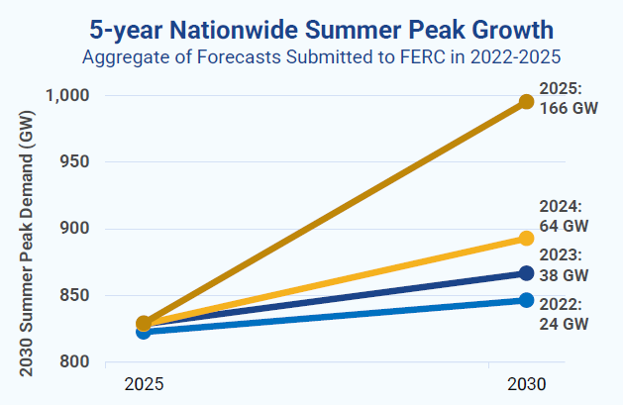
Long-term forecast predictability (“quantity” of demand)
FERC Forecast Revision Timeline
2022 24 GW — base scenario; AI not yet recognised as a demand driver
2023 38 GW — first significant upward revision; ChatGPT reshapes market expectations
2024 ~80 GW — hyperscalers multiply interconnection requests across all utility territories
2025 166 GW total, of which 90 GW
from data centres.
ENTSO-E EU network plan 2026:
EU data centre demand ×3 by 2030 vs. 2019
Source: Grid Strategies, Power Demand Forecasts Revised Up for Third Year Running, Led by Data Centers, Nov. 2025

Slide 4
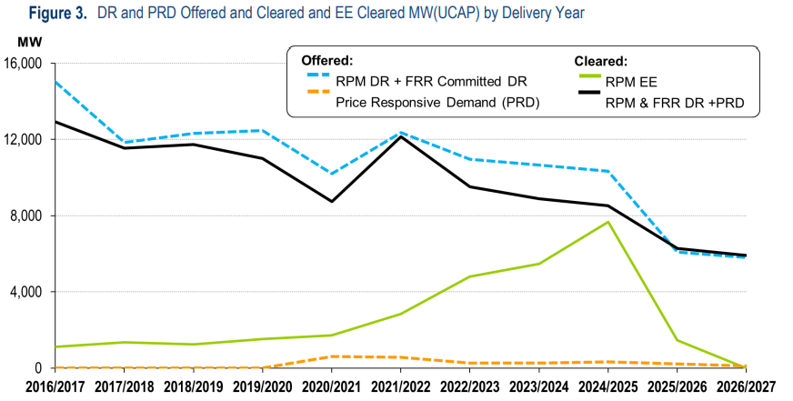
Limited or null demand flexibility (“quality” of demand)
PJM Base Residual Action
PRD Price Responsive Demand: remains extremely small (orange dotted line)
Source: PJM, Base residual auction report, Jul. 2025

Slide 5
Long-term forecast predictability: reasons for gaps
Five critical variables
Utilities forecasts
vs. Independent Analysts
Utility projections
(filed with FERC): 90 GW
Independent
analyst estimates: 65 GW
25 GW gap = +40% overestimation
≈ 2× New York City peak ·
≈ ½ Italy's national peak
1. Project realisation rate (will it actually be built?)
2. Actual vs. contracted load (peak ≠ average consumption)
3. Commercial operation date (can be delayed by months/years)
4. Ramp-up curve (not instantaneous)
5. Hourly load factor (training vs. inference profiles differ radically)
Source: Grid Strategies, Power Demand Forecasts Revised Up for Third Year Running, Led by Data Centers, Nov. 2025

Slide 6
Lessons learnt and good practices
① Standardised, transparent methodologies
The Capex bias:
Under cost-of-service regulation, overestimating is rational
Under this kind of regulation, utilities earn returns proportional to their rate base. Overestimating demand is not an error — it is the rational outcome of a misaligned incentive structure.
Probabilistic, not deterministic, planning assumptions.
Unified methodology with five mandatory metrics (realisation rate, load factor, date, ramp-up, cancellation probability).
② Regulatory incentives matter
“Least regret” criterion among different scenarios when calculating optimal capacity (*)
Output-oriented, rather than asset-based, regulatory incentive framework
③ Flexibility is not a luxury
In the EU, the Commission's Grid Package connection guidelines (2025) still need implementation
(*) A full example of application of “least regret” criterion: ESIG Large Loads Task Force, Transmission Planning with Large Loads, Current Practices and Recommendations, Jul. 2026. pp. 31-33

Slide 7
The Regulatory Toolkit
Lovins proposal
MANDATORY BONDING
Risk price discovery applied to demand-side infrastructure.
Bond markets price what regulators cannot: the real probability that forecast demand materialises.
Ireland CRU
BRING YOUR OWN GENERATION
Large load brings the capacity it needs — instead of requiring the system to build it.
Cost allocation radically different; system adequacy identical.
Combined with mandatory use of RES for 80% of time (Dec-25 decision)
US PJM
NON BACKED CAPACITY LOAD
Large loads can be interrupted in case of system stress
They are exempted to pay capacity market price component
Discrimination effect
Spain
CONCURSO DE DEMANDA
Environmental based score. Replaces First Come First Served principle
Renewables, flexibility, and low carbon commitment are rewarded.
Formally non-discriminatory — differentiates by objective policy criteria, not identity
ERRA organizes a workshop on AI Data Center impact on Power Systems and the role of Regulators
Athens, Oct. 27 2026
https://erranet.org/erra-workhop-on-power-systems-and-the-growth-of-ai-data-centers/

Slide 8
luca.loschiavo@erranet.org
101. (…) Current AI systems require enormous amounts of energy and water, significantly influencing carbon dioxide emissions, and place heavy demands on natural resources. As their complexity increases, especially in the case of large language models, the need for computing power and storage capacity grows too, which requires an extensive network of machines, cables, data centers and energy-intensive infrastructure. For this reason, it is essential to develop more sustainable technological solutions that reduce environmental impact and help protect our Common Home.
Encyclical Letter MAGNIFICA HUMANITAS
of His Holiness Pope Leo XIV

